Slide 1

BUSINESS ANALYSIS
CIS 5860 – SUMMER 2022 Prof. Arun Aryal

Slide 2

Presented by
BHAKTI PARMAR
CRISTINA BERGERE
PHUE THANT
PRATHUSHKUMAR DATHURI
RUTA ANTALIYA
Group 1

Slide 3
Overview of Business Analysis
Recognize the business requirements of stakeholders and come up with suitable solutions
Consists set of tasks, knowledge, and techniques required to identify business needs
Determine solutions to enterprise business problems and pursue the best opportunity or deal with the best problem
The business analyst and project, program, or portfolio manager should work closely together in highly mature businesses

Slide 4

Delivering project's solution is the main concern of the business analyst while determining the scope of the product
Ensures that customers are happy by finishing a project on schedule and within budget
Business analysis professionals within highly mature organizations spend 83% of their time working and applying business analysis on projects and programs.
Harmonious collaboration and appropriate task delegation within the team is critical to the success of the project

Slide 5
Causes of Project Failure
Poor Product Requirement
Poor Analysis Practice
Business Requirements not captured
Poor Project Management
Poor communication
Failure to update internal work-trackers and timesheets
Poor Strategic alignment
Inadequate business case, undefined problem
Business benefits not measured
Large and complex project so difficult to change

Slide 6
Poor Focus on Business Needs
Insufficient Resource allocation and prioritization
Inadequate Business involvement
Inadequate Stakeholder Management
Defining stakeholders too narrowly
Failure to maintain a balance between compliance and strategic opportunities
Stakeholders are unaware of project progress

Slide 7

Project Success rules
Identify and manage project stakeholder and their expectations.
Do not start development with poor product requirements and undefined scope.
Spending time on project initiation and planning.
Based on previous experience need to improve accuracy of estimation.
Identify project constraints with stakeholders.
Use risk management foresee problems and address potential problems
Make decision Smart and fast.

Slide 8
Roles and Responsibilities of Business Analysts

Slide 9
Solution evaluation
Validating the product against each requirement
Pre-project strategy work / Needs Assessment
Analyze a business problem
Identify an opportunity
Present an optimal solution to address the business need
Monitoring and Control
Measuring the performance to ensure goals are met on time
Business Analysis planning
Creation and preparation of WBS, Estimates, and Gantt Chart
Elicitation and Analysis
Elicitation – structured approach of drawing out information
Analyzing – Use case diagrams, User stories, Requirements prioritization
Notes:
Pre-project strategy work, also known as needs assessment –
Needs assessment includes the processes used to analyze a current business problem or opportunity, analyze current and future states to determine an optimal solution that will provide value and address the business need.
For e.g. during pandemic, online shopping of groceries is convenient for users and also provides safety stay at home option. So, a BA in Amazon would identify the needs to have a functionality in the app that provides this services to its user segment.
A proposal would be to acquire WholeFoods that would encourage people to signup for Prime memberships because they would get discounts on the shopping of groceries.
Business analysis planning
Roadmap to all the later business analysis tasks.
Preparation of WBS for all the work (list of activities) that would be needed to be done. It would have a logical grouping of all the activities for the purpose of planning a project.
Preparation of Estimates
How many resources would be needed for each activity and timelines
Creation of Gantt Chart
That would depict the workflow of the project wherein some of the tasks could be sequential and some could begin in parallel. It will discuss dependencies and durations of tasks based upon a calendar-based planning tool
https://business-analysis-excellence.com/business-analysis-planning-techniques/
Elicitation and Analysis
Structured approach of drawing out the information from the client or the SMEs regarding the requirements of the application / software development. It would include everything – gathering requirements, researching about it, defining them, refining them, etc.
To do this job a BA would –
1. Conduct interviews
2. Prepare questionnaires (having open and close ended questions)
3. Do brainstorming for what the app currently has and what can be improvised
4. Survey and Study the market to identify how can the competitive advantage of a product or application could be improvised
Requirement’s elicitation is very important to
1. Identify the scope of work
2. Allows development of relevant functionality
3. Also identifies any hidden or non-functional requirements
4. Identifying how to add business value
In case of agile this would be an iterative process
https://www.apriorit.com/dev-blog/699-requirement-elicitation
Analyzing these requirements will include
1. Identifying the actors and relationships with each use case (use case diagram)
2. Creating user stories followed by use case scenarios to include the constraints and conditions
3. Prioritizing the requirements
https://medium.com/omarelgabrys-blog/requirements-engineering-elicitation-analysis-part-2-a02db801f135
Monitoring and control
This is important to measure the performance and take corrective action to assure that the business is on track to meet the goals
To do this a regular assessment can be conducted on where the application team stands currently. If there are any potential issues, solutions must be proposed for the same.
Solution evaluation
This would act as a conformation that whatever requirements were specified in the use case descriptions, whatever flow was depicted in the activity diagrams and system sequence diagrams have been accordingly met in the solution developed.
Validating the functionality developed against each requirement listed.

Slide 10
Technical Aspects of Business Analysis

Slide 11
Agile
See the whole idea
Understand how all entities cooperate to create a working solution
Requires consistent communication
Use customer’s eye
Tailor the solution according to customers’ needs
Illuminates the problem
Determine what is valuable
Constantly conduct analyses to prioritize crucial activities and maximize value
Avoid waste
Incorporate only essential activities
Notes:
The purpose of implementing any Agile is to increase your business’s agility. Agile ensures that the business analysts can see the entire idea from start to finish. The analysts can also understand where each entity plays their part and the input they contribute to creating a solution. Additionally, the solution is oriented to the customer. It relies on how the customers perceive the problem and how they would like the solution to be. It also focuses on the valuable activities to maximize quality.

Slide 12
Agile – continued
Real examples
Incorporate real issues in analysis models to represent the final solution
Consider what is achievable
The solution must be achievable considering the timeline, resources, skills available, and technology available
Focus on collaboration and continuous improvement
Rely on feedback from all stakeholders
Highly iterative
Incremental
Notes:
For better understanding, agile incorporates real-life problems to represent the target goal. It also considers achievable targets, including available skills, technology, resources, and time. The goal is to avoid disorienting the schedule to achieve a viable solution. Additionally, it considers all stakeholders’ feedback to make continuous improvements until the solution is finalized.

Slide 13
Requirements Engineering
Feasibility study
Technical feasibility
Operational feasibility
Economic feasibility
Requirements gathering
Involves end users or customers
Specification of software requirements
Data flow diagrams
Data dictionaries
Entity relationship diagrams
Notes:
Involves checking whether the software is viable given the technology available, operations required, and financial profits expected. It uses various models to specify software requirements. data flow diagrams represent the information flow within the system, data dictionaries contain the systems memory and repository, and entity relationship diagrams represent relationships and their entity attributes.

Slide 14
Requirements engineering – continued
Software requirements validation
Confirm practicality and correctness of requirements
Software requirements management
Adjust to changes during requirements engineering
Notes:
Software requirements validation and management involve checking whether the requirements can be achieved, their correctness and incorporating changes during system development.

Slide 15


Data Visualization
representation of data through charts, graphics, plots, maps, etc.
Purposes:
Quickly examine large data
Make it easier to grasp difficult concepts
Understand trends and issues efficiently
Makes it faster and easier to point out areas of opportunities and concerns
Allow users and stakeholders to interact with data
Notes:
Data Visualization – representation of data through charts, graphics, plots, maps, etc. What makes it effective? – COMMUNICATION
- Communicating to stakeholders from the inside out to stimulate emotional response, then work towards a more rational approach to solve problems - BUSINESS ANALYSTS Use imagery to work their mental image of the outcome of the project that can influence customer’s appeal of a product
-They also facilitate stakeholders' collaboration, determine their needs and deliver solutions to underlying issues.
-They work very closely with the customer and technical leads to help create the technical design.
- Most importantly, serve as Liaison between data experts and technology departments
PURPOSES:
•The following are famous tools that analysts use to visualize data
•You have 3 seconds to guess what tool is used based on the picture presented

Slide 16
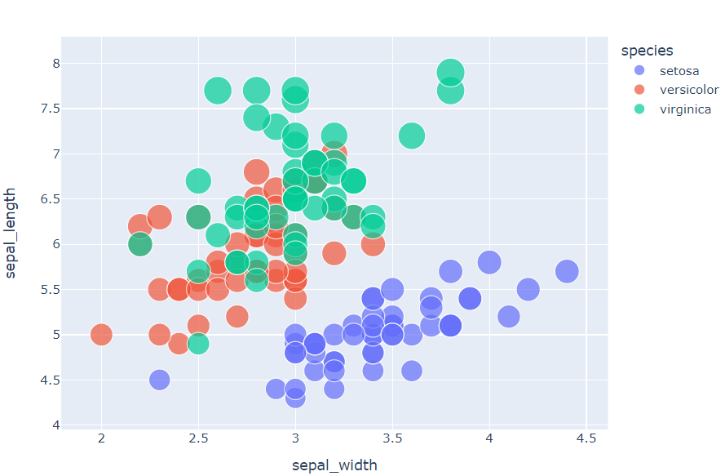

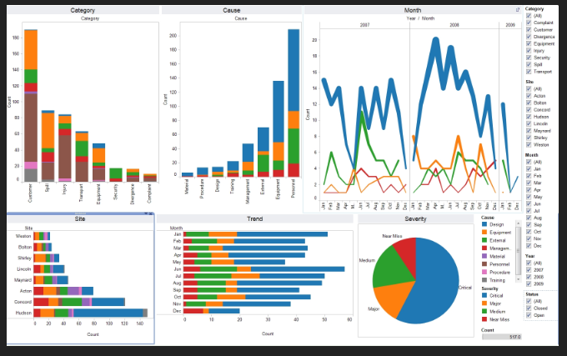
Data Visualization Tools
Jupyter
Notes:
•Jupyter – an interface for more than 10 programming languages
Tableu – easy to use and is known for providing efficient data in an interactive format that can be integrated with various other platforms for ease of use.

Slide 17
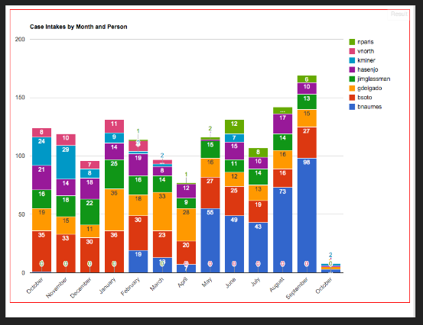
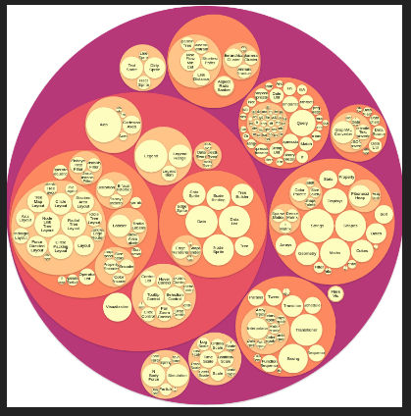
D3.js
Google Chart
Notes:
Google Chart - provides a wide range of graphics/charts D3.js - needs a background in JavaScript to work, it can take in large data and allow animations

Slide 18
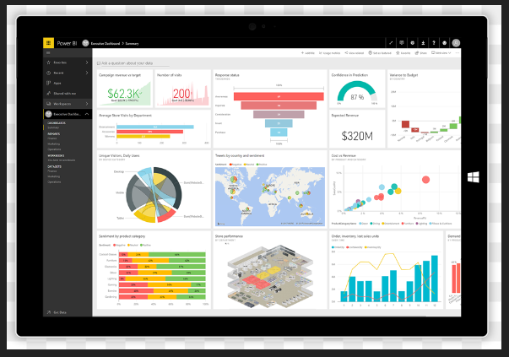

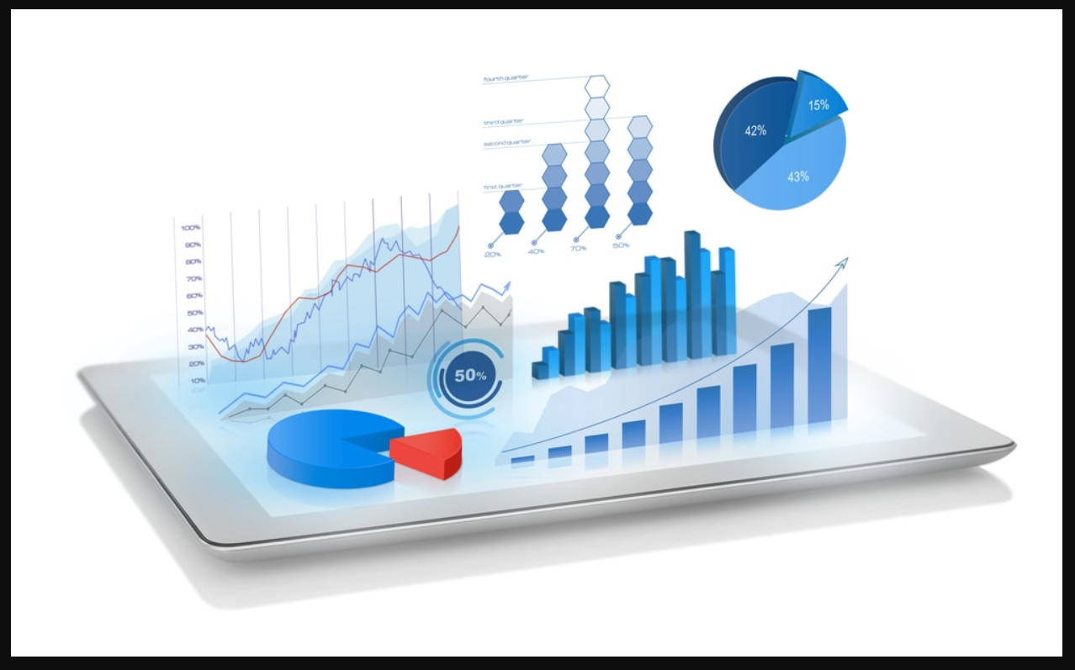


Notes:
Power BI – able to connect large data sets and custom visualizations. It works very well with power aps and SharePoint and can connect with servers directly
Inzata Analytics– best in data management, creating a data warehouse from different sources.
THAT CONCLUDES OUR PRESENTATION, THANKS SO MUCH FOR NOT WALKING AWAY!

Slide 19


Slide 20

Resources
https://www.pmi.org/learning/library/greatness-stakeholders-expectations-10207
https://www.pmi.org/learning/library/data-visualization-business-analysts-10198
https://www.pmi.org/learning/library/greatness-stakeholders-expectations-10207
https://data-informed.com/all-about-big-data-visualization/
https://jupyterbook.org/en/stable/interactive/interactive.html
https://barnraisersllc.com/2016/08/01/10-kpi-dashboard-templates-keep-strategy-track/
https://www.zerobluetech.com/portfolio-item/google-chart-in-a-filemaker-database/
https://www.inzata.com/wp-content/uploads/2019/06/shutterstock_488322949.jpg
https://www.proofhub.com/articles/reasons-why-projects-fail
https://origin-learning.medium.com/why-workplace-learning-projects-fail-what-we-can-learn-from-it-673d01d5b027
https://www.slideshare.net/MariannaAlmakaieva/10-reasons-why-projects-fail-or-common-mistakes-to-avoid
https://ww1.prweb.com/prfiles/2020/06/22/17208497/inzata_logo_Wht_BG.png
https://www.pmi.org/learning/library/greatness-stakeholders-expectations-10207​
https://www.pmi.org/learning/library/data-visualization-business-analysts-10198​

Slide 21

Thank You!

